Slide 1
DSI- Project 3
Ivy Chan

Slide 2
Problem Statement
Documention classification in the past used to be done manually and requires high labour hour.
As a marketer who is intereted in identify what are the keywords that users in the Reddit community use when discussing on 2 topics: coffee and restaurant so that the keywords can be later used in content creation.
In this project, We will train a classifier to take in text input and then classify to which group the text belongs to in order to reduce labour hour and increase classification accuracy.

Slide 3
Data Collection: Scrap Data Using Reddit API (I)
Data of 2 subreddit: Coffee & Restaurant were scrapped using Reddit API.
After getting our url in json, request is sent to Reddit using a non-deafault value for the key 'User-agent' to prevent Reddit from shutting our script from accessing its API.
A status code of 200 shows that the request was received and understood ad is being processed.
The Json file received is a nested dictionary, access to key 'data' and then key'children' to get the "content".

Slide 4
Data Collection: Scrap Data Using Reddit API (II)
As each Reddit request will only return 25 posts, a for loop is used to hit Reddit API repeatedly to collect a minimum of 1000 posts from each subreddit. The for loop will have an empty list created to store Arandom sleep duration is included at the end of loop to give anatural break in between request.
The scraped data is saved in a Pandas Dataframe and exort as csv file.

Slide 5
Subreddit Topic Selected:
Coffee
1245 rows,99 columns
Duplicate Post: 288 (23% of the datasets)
Selftext Null Value: 53 (4% of the removed duplicate datasets)
Observations: 960
Restaurant
1228 rows, 104 columns
Duplicate Post: 764 (62% of the datasets)
Selftext Null Value: 176 (38% of the removed duplicate datasets)
Observation: 464

Slide 6
Data Cleaning:
Remove Duplicate Posts
Fill in null value with Title
Split both subreddit into 2 parts:
Training Datasets- (80%)- For Model Development
Coffee- 768
restaurant-371
Testing Datasets- (20%)- For Performance Evaluation
Coffee- 192
restaurant - 93
Map and Label Subreddit: Coffee:0, restaurant:1

Slide 7
Preprocessing:
Create a function to:
Remove html
Remove http & www
Remove special elements ie. /r/|\n|&lt;|&gt;
Remove punctuation, change to lower case
Remove stop word
Remove Emoji
Return as a clean string of words and store in 2 lists
Traning_self_text
Testing_self_text

Slide 8
Train-Test_Split
Subreddit
(100%)
Training Data Sets
(80%)
Train
(Stratify)
Validation
(Stratify)
Testing Data Sets
(20%)

Slide 9
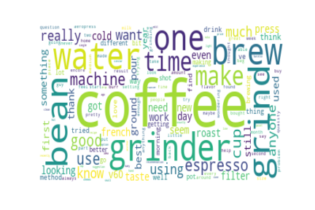
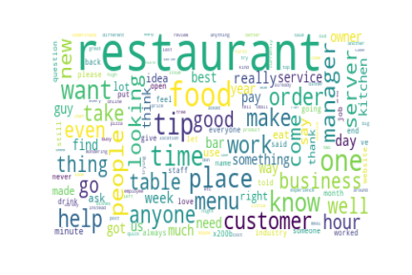
WordCloud
Subreddit Coffee
Subreddit Restaurant

Slide 10
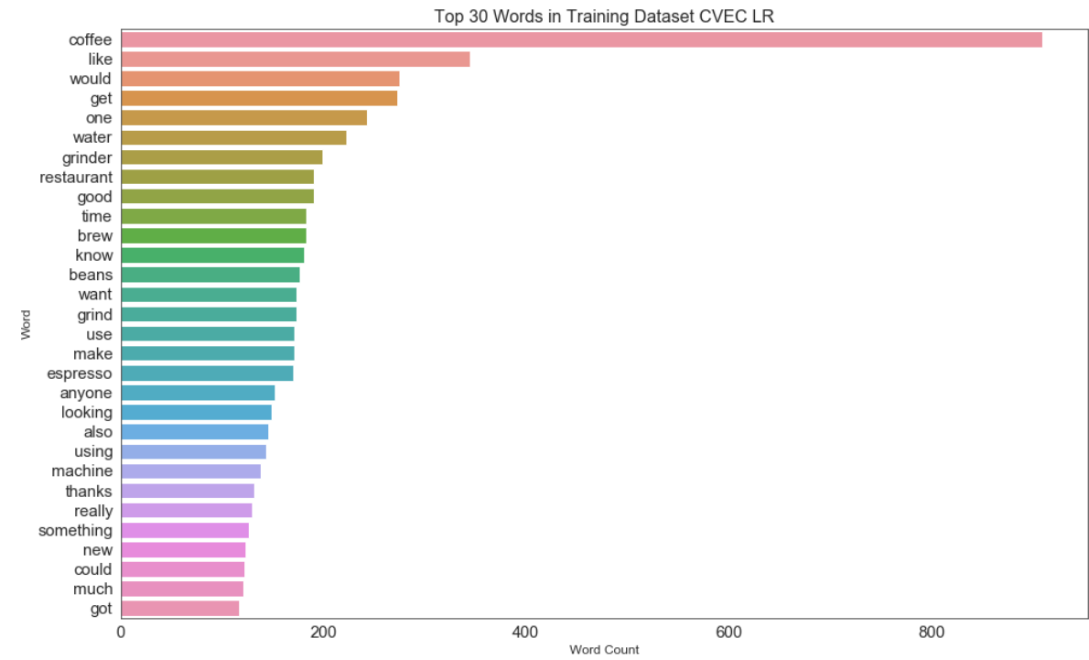
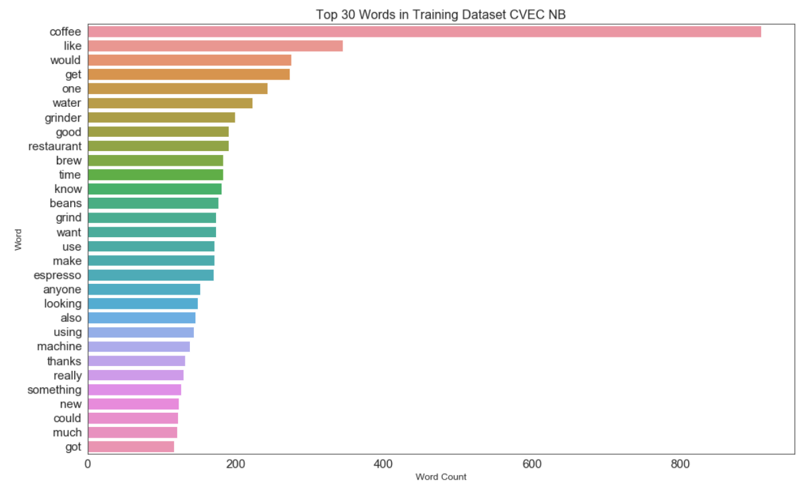
Top 30 Words & Counts for 2 Model
The Sequence Words Count in descending for is slightly different for both model.

Slide 11
Models & Scores:
 | Train Score | Validation Score
Baseline Accuracy | Subreddit 0: 0.6742 Subreddit 1: 0.3257
CountVectorizer Logistic Regression | 0.9988 | 0.9684
CountVectorizer Logistic Regression with Best Parameter | 0.9976 | 0.9508
CountVectorizer Multilinear Naive Bayes | 0.9906 | 0.9508
CountVectorizer Multilinear Naive Bayes with Best Parameter | 0.9871 | 0.9508
Using Best Model to do Prediction with Testing Data | Score on Testing Data: 0.9473

Slide 12
Conclusion
The best model chosen in this project is CountVectorizer Multinomial Naive Bayes tuned with hyperparameter withe the final prediction score of 94.73%.
In this project, the Key Merics we are looking at Accuracy as any misclassification in the subreddit post will result in an ambiguos state as to which group of subject this word belongs to when creating content.

